Slide 1
Reactjs (17.0.2)
A JavaScript library
for building user interfaces
reactjs.org

Slide 2
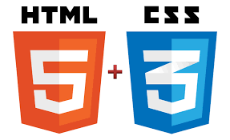

Prerequisites
Familiarity with HTML and JavaScript
ES6, a recent version of JavaScript
Arrow functions, classes, let, and const statements

Slide 3

What is React
React is a declarative, efficient, and flexible JavaScript library for building user interfaces.

Slide 4

Installing Node js
Go to https://nodejs.org/en/
Download the latest version of Nodejs
Install nodejs
Verify the installation
  Open a Console Terminal ( Command Prompt )
  Type: node -v (14.17.6)
  Check npm: npm -v (6.14.15)
  npx –v (6.14.15)
Notes:
LTS - Long Term Support
(Dec 10)
Npm / npx –v 6.13.2
Node – 13.3.0
npx is a Node.js command-line tool which became available with npm@5.2.0. It enables npm to eXecute command-line Node.js tools without having them to be installed globally.
Command-line tools like mocha, gulp, react-native etc., are commonly installed globally using the -g flag with npm.
However, a globally installed package has two major problems:
Different projects may depend on different versions of the same package
Users may be reluctant to install a global utility just for your project
When using npx, all you have to do is install the "global" command-line tool under your dependencies or devDependencies, it can then be executed within the context of the project directory using npx, without them actually being installed globally.

Slide 5
Using live-server
Install live-server
  #> npm i live-server –g
Start live-server
  live-server - -port=8080
This will start the live server in port no 8080 and will load index.html from the current directory to the default browser

Slide 6
First React Page
React application from a HTML page

Slide 7
Running a simple React application from a HTML page
<head> <title>Hello World</title>
  <script src="https://unpkg.com/react/umd/react.development.js"></script>
  <script src="https://unpkg.com/react-dom/umd/react-dom.development.js"></script>
  <script src="https://unpkg.com/babel-standalone/babel.min.js"></script>
</head>
<body>
<div id="root"></div>
<script type="text/babel">
ReactDOM.render(<h1> Hello, world! </h1>, document.getElementById('root') );
</script> </body>
Notes:
https://reactjs.org/docs/add-react-to-a-new-app.html
<!DOCTYPE html>
<html>
<head>
<meta charset="UTF-8" />
<title>Hello World</title>
<script src="https://unpkg.com/react@16/umd/react.development.js"></script>
<script src="https://unpkg.com/react-dom@16/umd/react-dom.development.js"></script>
<script src="https://unpkg.com/babel-standalone@6.15.0/babel.min.js"></script>
</head>
<body>
<div id="root"></div>
<script type="text/babel">
ReactDOM.render(
<h1>Hello, world!</h1>,
document.getElementById('root')
);
</script>
</body>
</html>

Slide 8
Second Page
document.createElement()

Slide 9
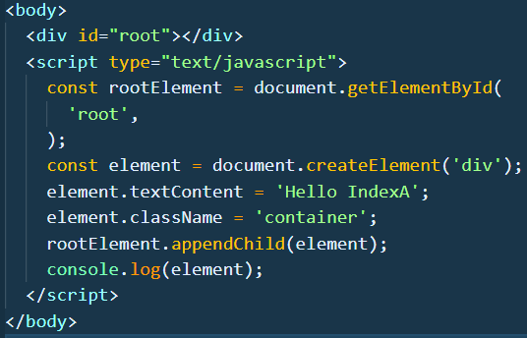

document.createElement()

Slide 10

Demo – React.createElement

Slide 11
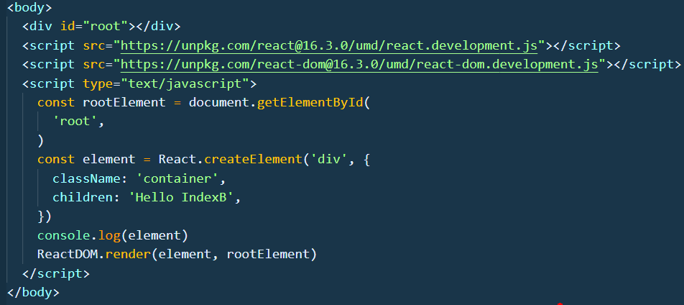
React.createElement

Slide 12
Using live-server
Start live-server
  live-server - -port=8080
This will start the live server in port no 8080 and will load index.html from the current directory to the default browser

Slide 13
Index.html
We have to load 3 latest stable versions of the libraries from CDN in the head
React - the React top level API
React DOM - adds DOM-specific methods
Babel - a JavaScript compiler that lets us use ES6+ in old browsers
Add a <div> element with an id called root, which will be the entry point for our app.
The <div> element is named by convention as root, and
Finally we'll create a <script> tag where the custom javascript code will live
The script type must be text/babel, which is mandatory for using Babel

Slide 14
<script crossorigin src="https://unpkg.com/react@16/umd/react.development.js"></script>
<script crossorigin src="https://unpkg.com/react-dom@16/umd/react-dom.development.js"></script>
The versions above are only meant for development, and are not suitable for production. Minified and optimized production versions of React are available at:
<script crossorigin src="https://unpkg.com/react@16/umd/react.production.min.js"></script>
<script crossorigin src="https://unpkg.com/react-dom@16/umd/react-dom.production.min.js"></script>
To load a specific version of react and react-dom, replace 16 with the version number.
Note:
CDN – Content Delivery Network
Notes:
CDN – Content Delivery Network

Slide 15
CDN
A content delivery network (CDN) refers to a geographically distributed group of servers which work together to provide fast delivery of Internet content.
A CDN allows for the quick transfer of assets needed for loading Internet content including HTML pages, javascript files, stylesheets, images, and videos.
Today the majority of web traffic is served through CDNs, including traffic from major sites like Facebook, Netflix, and Amazon.
A properly configured CDN may also help protect websites against some common malicious attacks, such as Distributed Denial of Service (DDOS) attacks.

Slide 16
ReactDOM
The react-dom package provides DOM-specific methods that can be used at the top level of the web app
render()
ReactDOM.render(element, container[, callback])
Render a React element into the DOM in the supplied container and return a reference to the component (or returns null for stateless components).
If the React element was previously rendered into container, this will perform an update on it and only mutate the DOM as necessary to reflect the latest React element.

Slide 17

Babel
Babel is a JavaScript compiler.
Babel is a tool chain that is mainly used to convert ECMAScript 2015+ code into a backwards compatible version of JavaScript in current and older browsers or environments.
Babel has support for the latest version of JavaScript through syntax transformers.
These plugins allow you to use new syntax, right now without waiting for browser support.
url: https://babeljs.io/docs/en/index.html

Slide 18
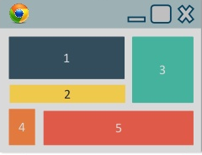
Demo - React Component

Slide 19
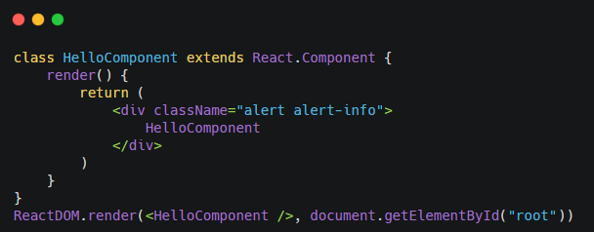
React Component
Now, using ES6 classes let's create a React component called HelloComponent that inherits from React.Component in a js file (app.js).

Slide 20
render() method
Add the render() method to render DOM nodes.
render() is the only required method in the class component.
Inside the return, we're going to put JSX what looks like a simple HTML element.
Finally, we're going to use the React DOM render() method to render the class we created into the root div in our HTML.
In the html file load in the script file (app.js):
<script type="text/babel" src="app.js"></script>
Now if you view the index.html in the browser, you'll see the JSX element we created rendered to the DOM.

Slide 21

create-react-app
Notes:
create-react-app 3.3.0

Slide 22
create-react-app
Create React App doesn’t handle backend logic or databases.
It just creates a frontend build pipeline, so you can use it with any backend.
It uses build tools like Babel and webpack under the hood, but works with zero configuration.
When you’re ready to deploy to production, running npm run build will create an optimized build of your app in the build folder

Slide 23
Create a new react project (node >= 6.x)
npm install -g create-react-app ( this will take a few seconds )
create-react-app << new app name>> | create-react-app lessona
npm naming restrictions: * name can no longer contain capital letters
  Creating a new React app in C:\..\lessona.
  Installing packages. This might take a couple of minutes.
  Installing react, react-dom, and react-scripts...
npx create-react-app << new app name>>
*npx is a package runner tool that comes with npm 5.2+.

Slide 24
Create a new react project (node >= 6.x)
npm install -g create-react-app ( this will take a few seconds )
create-react-app << new app name>> | create-react-app lessona
npm naming restrictions: * name can no longer contain capital letters
  Creating a new React app in C:\..\lessona.
  Installing packages. This might take a couple of minutes.
  Installing react, react-dom, and react-scripts...
npx create-react-app << new app name>>
*npx is a package runner tool that comes with npm 5.2+.

Slide 25
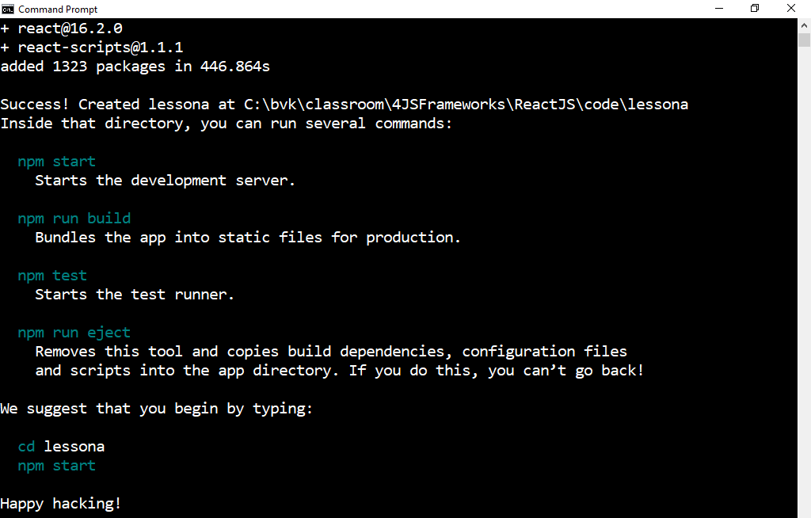

Slide 26
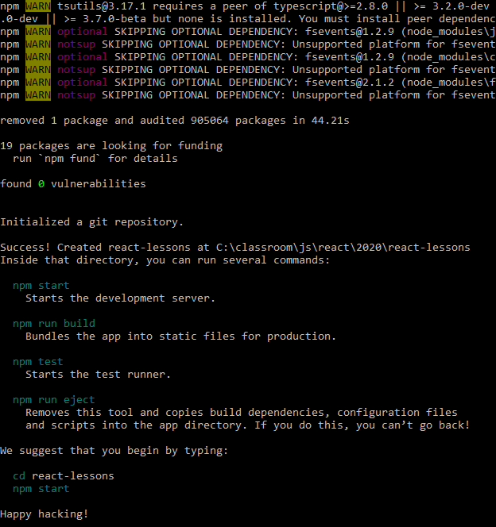
Using npx
npx create-react-app react-demo-app
naming restrictions: * name can no longer contain capital letters
Creating a new React app in C:\..\lessona.
Installing packages. This might take a couple of minutes.
Installing react, react-dom, and react-scripts...

Slide 27
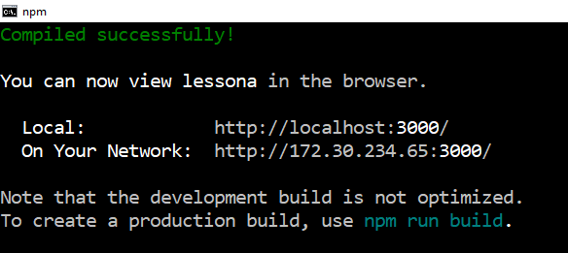
Start the project
Cd << new project name>> | cd lessona
npm start

Slide 28
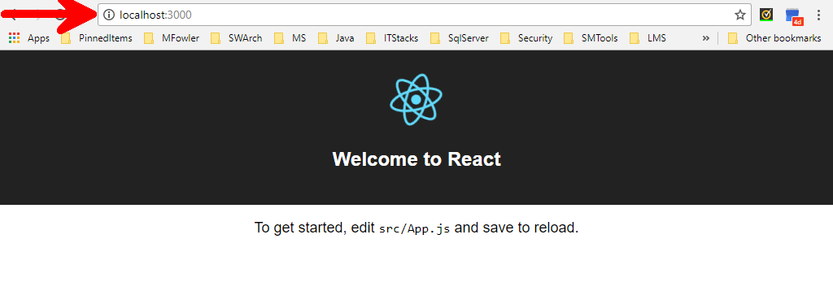

Slide 29
The Initial Project Structure
my-app
├── README.md
├── node_modules
├── package.json
├── .gitignore
├── public
│ ├── favicon.ico
│ ├── index.html
│ ├── logo192.png
│ ├── logo512.png
│ ├── manifest.json
│ └── robots.txt
└── src
├── App.css
├── App.js
├── App.test.js
├── index.css
├── index.js
├── logo.svg
└── serviceWorker.js
Inside the project directory, create-react-app will generate the initial project structure and install the transitive dependencies

Slide 30
Folder Structure
The following files must exist with exact filenames:
  public/index.html is the page template;
  src/index.js is the JavaScript entry point.
Rest of the files can be deleted or renamed
Subdirectories can be created inside src.
For faster rebuilds, only files inside src are processed by Webpack.
You need to put any JS and CSS files inside src, otherwise Webpack won’t see them.
Only files inside public can be used from public/index.html.
You can, however, create more top-level directories. They will not be included in the production build so you can use them for things like documentation.

Slide 31
The file index.html in /public folder is very similar to the static index.html file we made earlier - just a root div.
This time, no libraries or scripts are being loaded in.
The /src directory will contain all our React code.
To see how the environment automatically compiles and updates the React code, find the line “Edit <code>src/App.js</code> and save to reload. ” in /src/App.js and replace it with any other text.
Once you save the file, you'll notice localhost:3000 compiles and refreshes with the new data.

Slide 32

Visual Studio Code
https://code.visualstudio.com/Download

Slide 33
serviceWorker.unregister()
It lives inside the browser and it sits between your web pages and your application servers.
Once installed and activated, a ServiceWorker can programmatically determine how to respond to requests for resources from your origin, even when the browser is offline.
ServiceWorker can be used to power the so-called “Offline-First” web
There’s a few hard requirements when it comes to ServiceWorker.
  First and foremost, the site needs to be served over a secure connection. (HTTPS)
Notes:
https://ponyfoo.com/articles/simple-offline-site-serviceworker

Slide 34
Registering the ServiceWorker
Service workers can meaningfully speed up repeat visits to your web app, but you should take steps to ensure that a service worker's initial installation doesn't degrade a user's first-visit experience.
Generally, deferring service worker registration until after the initial page has loaded will provide the best experience for users, especially those on mobile devices with slower network connections.
Notes:
https://developers.google.com/web/fundamentals/primers/service-workers/registration

Slide 35
Using template

Slide 36
Selecting a template
A new app can be created from a template by appending --template [template-name] to the creation command.
If a template is not selected, then the project is created with the base template.
Templates are always named in the format cra-template-[template-name].
npx create-react-app my-app --template [template-name]

Slide 37
Creating a TypeScript app
You can start a new TypeScript app using templates.
  npx create-react-app my-app --template typescript

Slide 38
Available Scripts
npm start
npm test
npm run build
  Builds the app for production to the build folder.
  It correctly bundles React in production mode and optimizes the build for the best performance.
  The build is minified and the filenames include the hashes. If necessary, classnames and function names can be enabled for profiling purposes

Slide 39
Create React App is divided into two packages:
  create-react-app is a global command-line utility that is used to create new projects
  react-scripts is a development dependency in the generated projects.
npx create-react-app my-app automatically installs the latest version of Create React App
Create React App creates the project with the latest version of react-scripts automatically

Slide 40
Linting
Linting is the process of running a program that will analyse code for potential errors.
The linter output can be seen right in the terminal as well as in the browser console.
To see the lint results in the editor, install an ESLint plugin/extension.

Slide 41
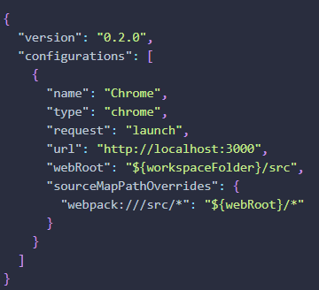
Debugging in the Editor
Install Chrome Debugger Extension
Then add the block below to the launch.json file and put it inside the .vscode folder in your app’s root directory.

Slide 42


JSX
We will examine the building blocks of React apps: elements and components.

